Slide 1
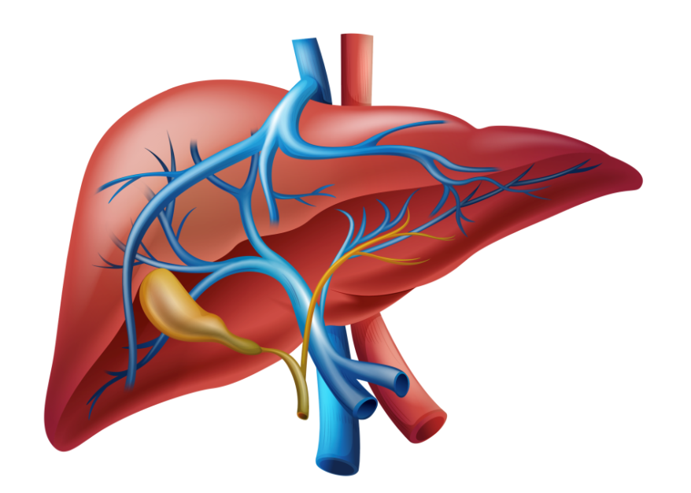
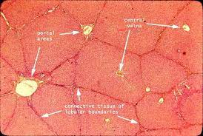
Histology of liver

Slide 2
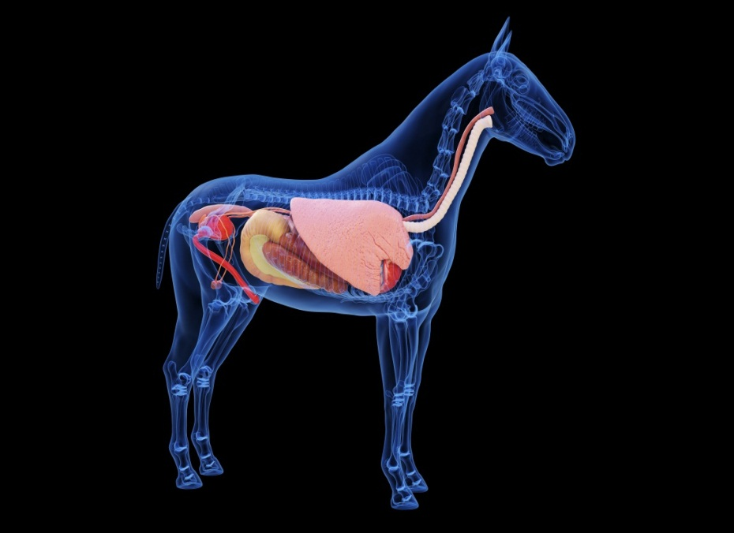
liver
Anatomically
It is the largest multilobulated gland in the body located in the right hypochondria below the diaphragm,

Slide 3
Functions of livers
1-Metabolic Functions :- carbohydrate metabolism, lipid, protein, mineral and vitamin metabolisms
2. Excretory Functions:- Bile pigments, bile salts and cholesterol are excreted in bile into intestine.
3. Protective functions & detoxification:- Kupffer cells of liver perform phagocytosis to eliminate foreign compounds. For example ammonia is detoxified to urea and metabolism of xenobiotics (detoxification).Clearance of hormones such as insulin, parathyroid hormone, oestrogen, cortisol .
4. Hematological and synthetic functions:- formation of blood (particularly in fetus) , plasma proteins (albumin and prothrombin), hormones e.g angiotensinogen, insulin like growth factor and triiodothyronine, and d estruction of erythrocytes (Bilirubin)
5.Storage functions:- Glycogen, vitamins A, D and B12.
6. Serum enzyme:- Acting as markers of liver damage.

Slide 4
Histological structures of liver
stroma
parenchyma
connective tissue capsule
Trabecula or septa
Reticular fibers
Hepaocytes
Blood vessels
Bile ducts

Slide 5
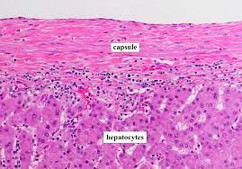
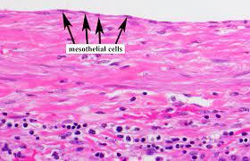
structures of liver
1-Stroma
1- c.T capsule: called Glisson’s capsule
Consist of connective tissue , contain blood vesseles , covered by a layer of mesothelium.
* The connective tissue of stroma contain collagen type ІІІ which form a meshwork that provide integrity for hepatocytes and sinusoids
.

Slide 6
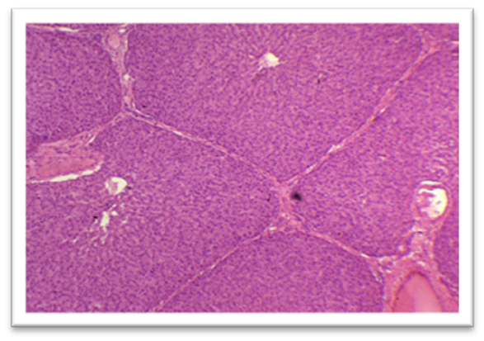
structures of liver
1-Stroma
2-c.t septa or trabeculae:
arise at the hillum (the porta hepatis) , the c.t tissue capsule extended in to the interior of liver as a numerouse branching trabeculae and septa dividing the liver into lobes and lobules
-interlobar septa
-interlobular septa
The structure of the classic lobule is most clearly visualized in the pig because of its plentiful array of connective tissue dividing the liver into discrete hexagonal lobules with a portal area at the corners of each hexagon.

Slide 7
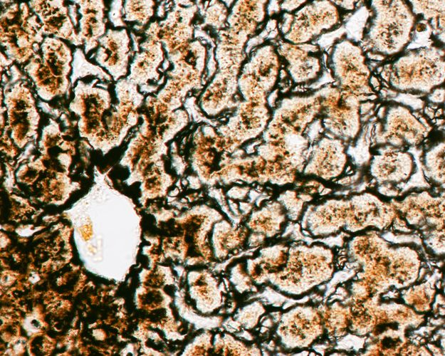
structures of liver
1-Stroma
3- reticular fibres :
-support the parenchyma.
-lined the sinusoid, support the endothelial cells , and form a denser network of reticular fibre in the wall of central vein
-also merge with the collagen fibers in the interlobular septum, when they surround the portal vein and the bile duct.

Slide 8
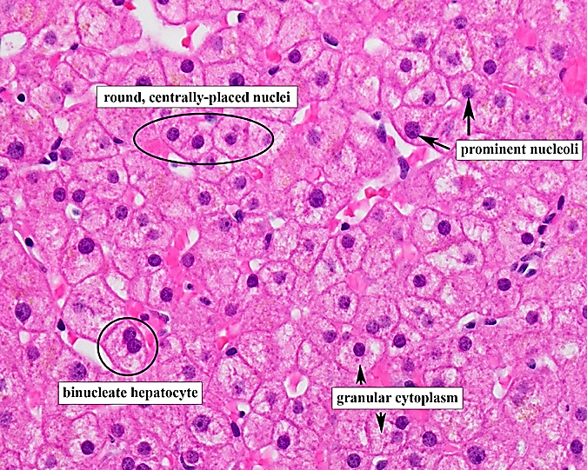
structures of liver
2-parenchyma
Hepatocyte
L M:
Hepatocytes are polyhedral in shape, with rounded, centrally placed nucleus. Some of hepatocytes are binucleated.
The cytoplasm is acidophilic (large number of mitochondria and sER and pale (presence of glycogen and lipid droplets).

Slide 9
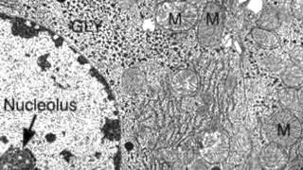
structures of liver
2-parenchyma
Hepatocytes
EM:
1-Abundant mitochondria(high metabolic activity)
2-well developed rER(protiens synthesis)
3-multiple Golgi (scretory activity)
4-abundant sER(synthesis of bile & glycogen, detoxification)
5-lyposome and lipofuscin pigments(aged cell)
6-Glycogen and lipid(energy)

Slide 10
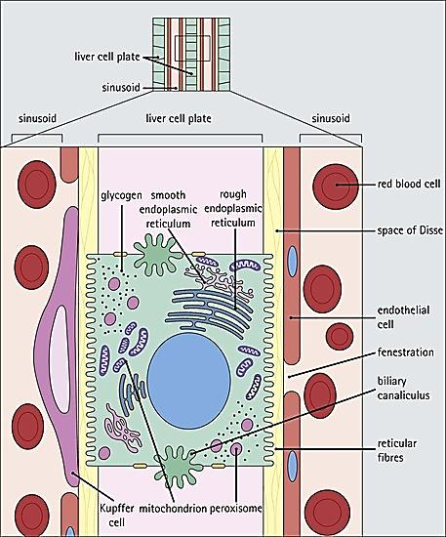
Hepatocytes
The hepatocyte has two functional surfaces
1- the vascular side
*Faces the perisinusoidal space
*It show long microvilli
2- intercellular side
*when the bile canaliculi are enclosed between adjacent hepatocytes
*each bile canaliculi shows short microvilli project into its lumen and bounded by tight junction and desmosome

Slide 11
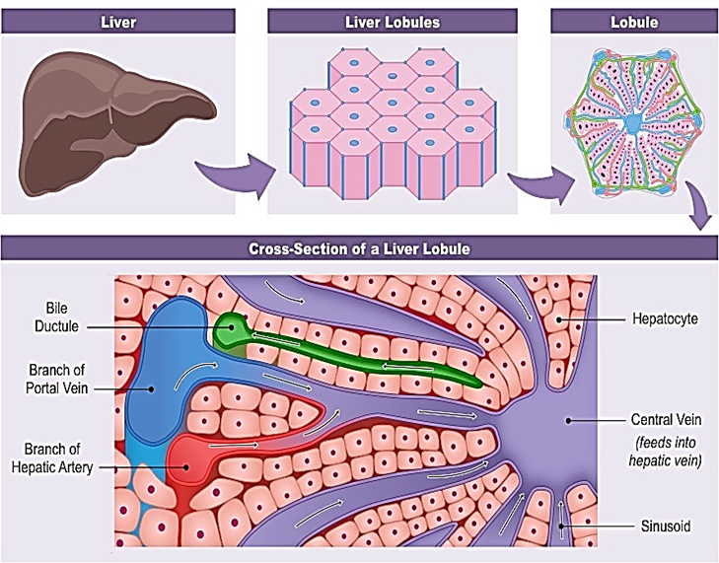
structures of liver
Hepatocytes:
Organized as a high numbers of small hepatic lobules( structural units of liver)
Arranged in anastomosing cords , radiating irregularly from a central vein to the outward known as hepatic lamina
These hepatocytic cords enclosed between them bile canaliculi and are separated from each other by blood sinusoids.

Slide 12
Fig :liver (ox). (1) Hepatocytes arranged in cords. (2) Sinusoids lined by endothelial cells and macrophage open into (3) the central vein. Safranin/haematoxylin.×125
Liver in ox

Slide 13
Liver in horse
This micrograph of horse liver shows a central vein surrounded by radiating cords of hepatocytes that contain large, smoothly round vacuoles which occupy most of the cell and displace the nucleus to the periphery. H & E. ×250

